Slide 1
Today is the 29 th of November, Tuesday
STAGES OF OUR WORK
GREETING.
SPEECH AND WORD DRILLS.
HOME TASK CHECKING.
VOCABULARY.
THE WORK WITH THE TEXT.
LISTENING COMPREHENSION
SPEAKING – SITUATION DIALOGUES.

Slide 2
оканчивать школу |  | учиться хорошо
сдать экзамены |  | оборудование
занимать |  | здоровье
вести обучение |  | проходной балл
посещать занятия (лекции) |  | перемена
пешком |  | час учебных занятий
буфет, столовая |  | спортивный зал
художественная литература |  | семестр
мастерские |  | общежитие
учебный год |  | стипендия

Slide 3
оканчивать школу | to leave school | учиться хорошо | to do well
сдать экзамены | to pass exams | оборудование | equipment
занимать | to occupy | здоровье | health
вести обучение | to run | проходной балл | level pass
посещать занятия (лекции) | to attend classes (lectures) | перемена | a break
пешком | on foot | час учебных занятий | an hour, a period
буфет, столовая | canteen | спортивный зал | gym
художественная литература | fiction | семестр | term
мастерские | workshops | общежитие | hostel
учебный год | academic session | стипендия | scholarship

Slide 4
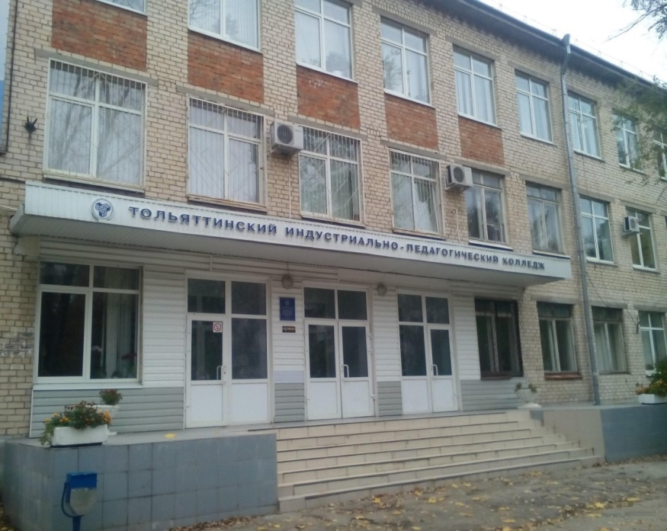
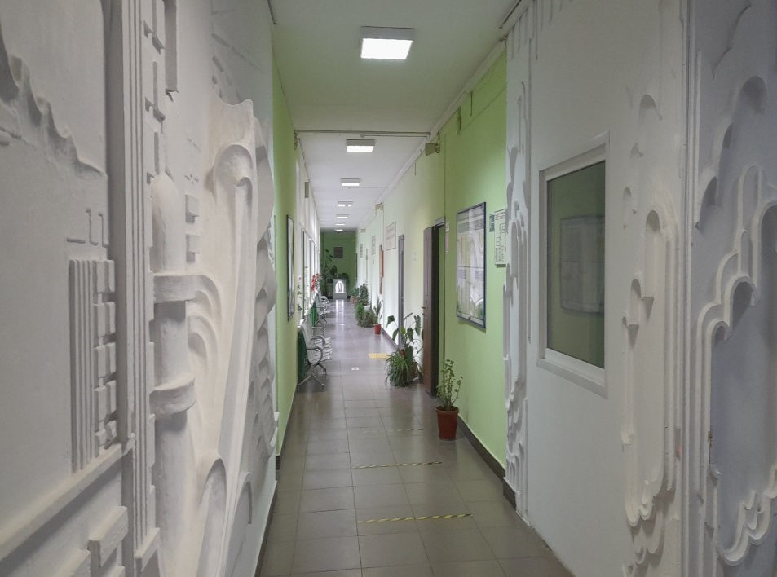
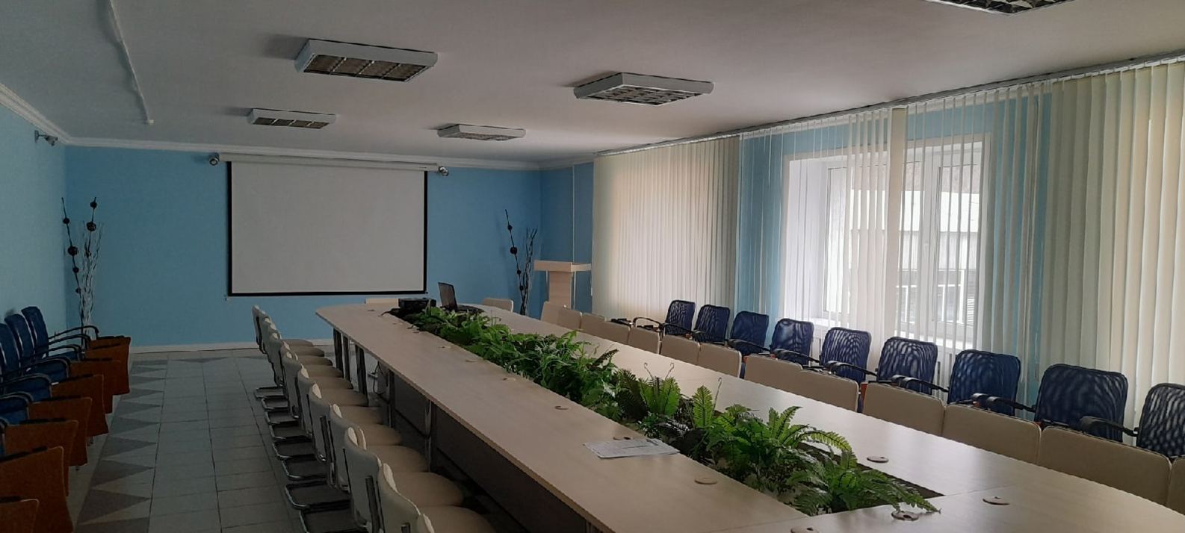
ОТКРЫТЫЙ УРОК ПО УЧЕБНОМУ ПРЕДМЕТУ «ИНОСТРАННЫЙ ЯЗЫК» ПО ТЕМЕ «The description of the college (building, atmosphere, living conditions, machinery, equipment»
Преподавателя
Барановой Елены Анатольевны.
в группе Р - 122

Slide 5
1. Paul is good at tennis. He ... tennis very well.
a) play b) played c) plays d) will play
2. Suzy ... to rock music ten minutes ago.
a) listened b) listens c) will listen d) listen
3. Many birds ... south every summer.
a) will fly b) fly c) flew d) flies
4. Mr. Black ... computer in several minutes.
a) use b) used c) will use d) uses
5. Jack usually ... to work on Saturdays.
a) don't go b) didn't go c) doesn't go d) won't go
6. Dick ... help students with the projects next week.
a) won't b) doesn't c) didn't d) don't
7. It ... rain last week.
a) doesn't b) didn't c) won't d) don't
8. Cats ... very well in the dark.
a) saw b) will see c) sees d) see

Slide 6
The description of the college
(building, environment, living conditions,
machinery, equipment)"
There are a lot of different professions in this world
And all professions are important.
But I consider the professions of our college to be the best and in demand

Slide 7
В мире существует множество
самых разных профессий.
И все профессии важны.
Но профессии нашего колледжа
я считаю
самыми лучшими и востребованными!

Slide 8
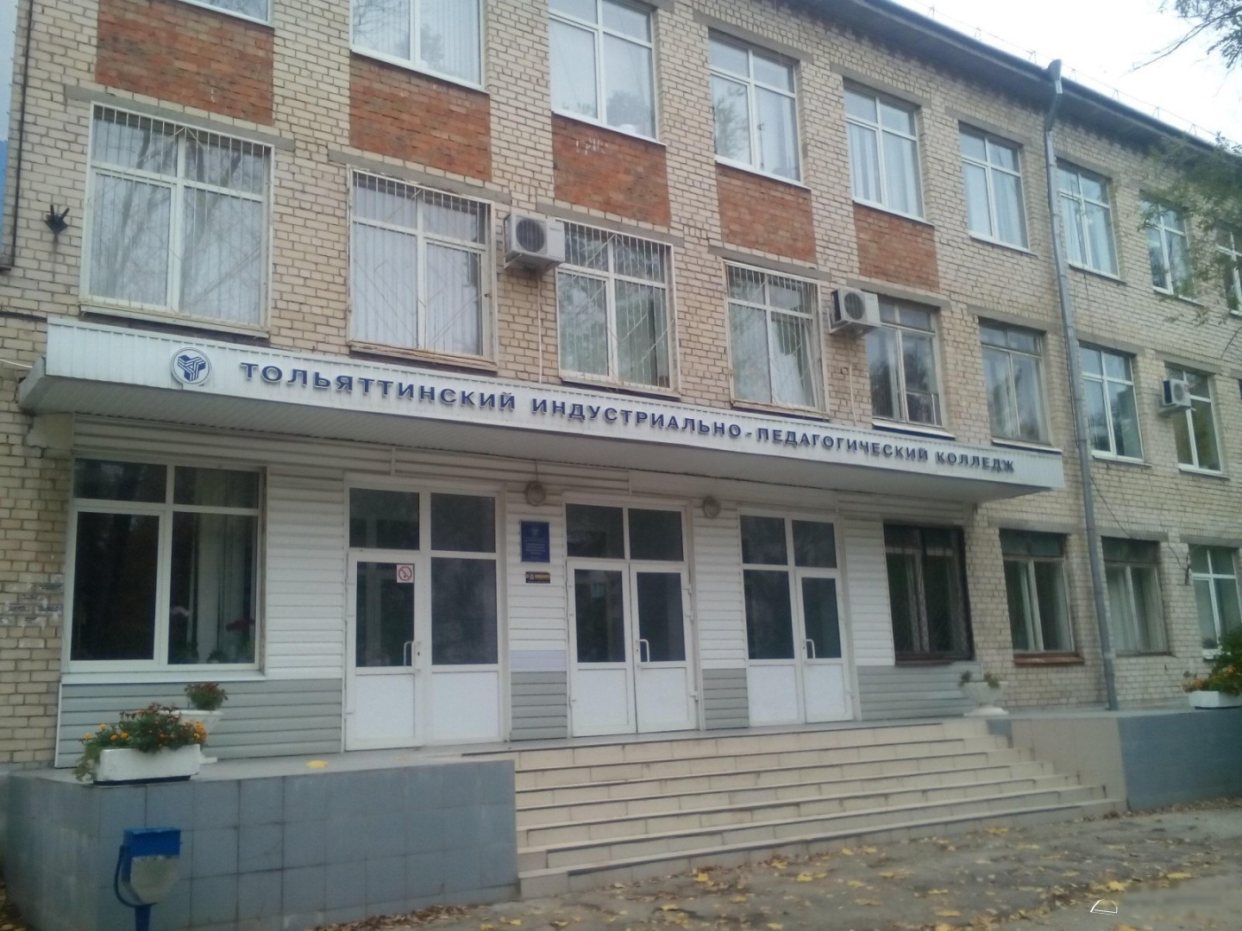
This is the entrance through which students come to college every day to gain knowledge and skills. Many different future professionals study at this place.

Slide 9
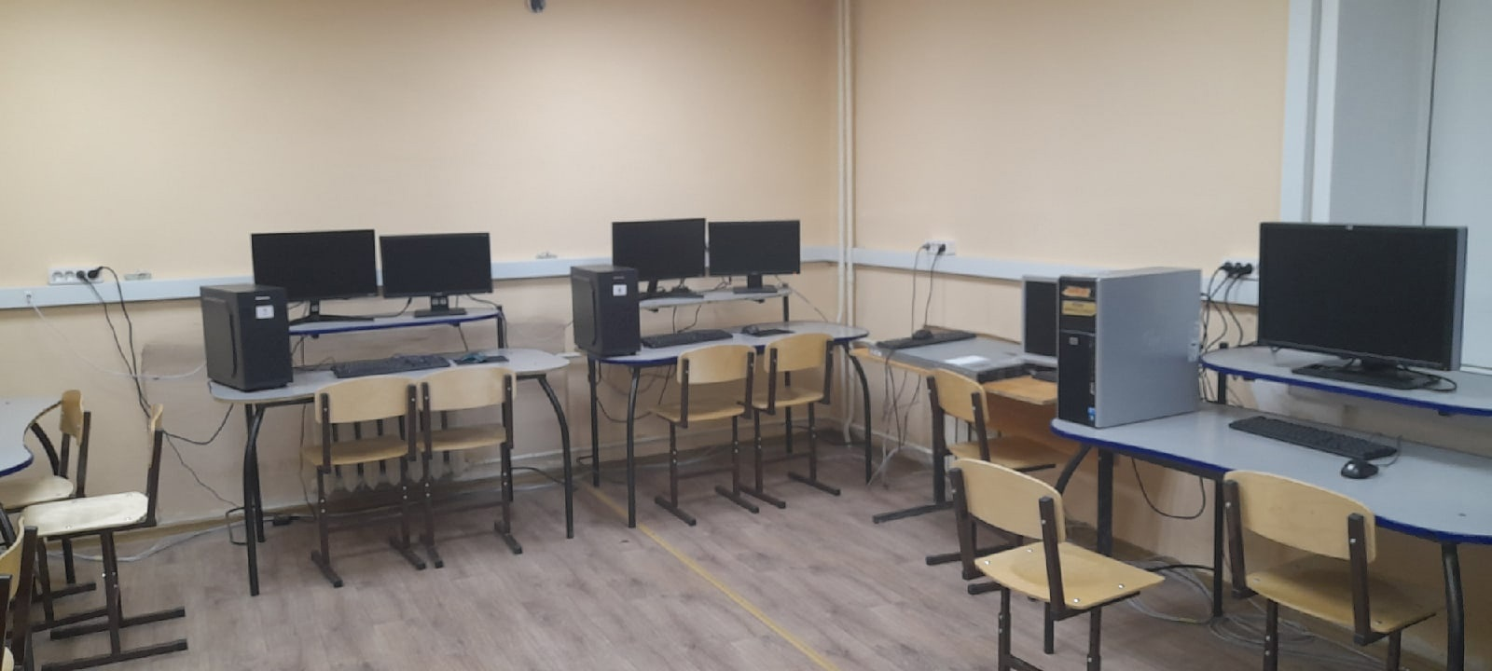
This is a laboratory where future system administrators and programmers are trained. They create virtual networks here and configure them in order to have good practice in the future.

Slide 10
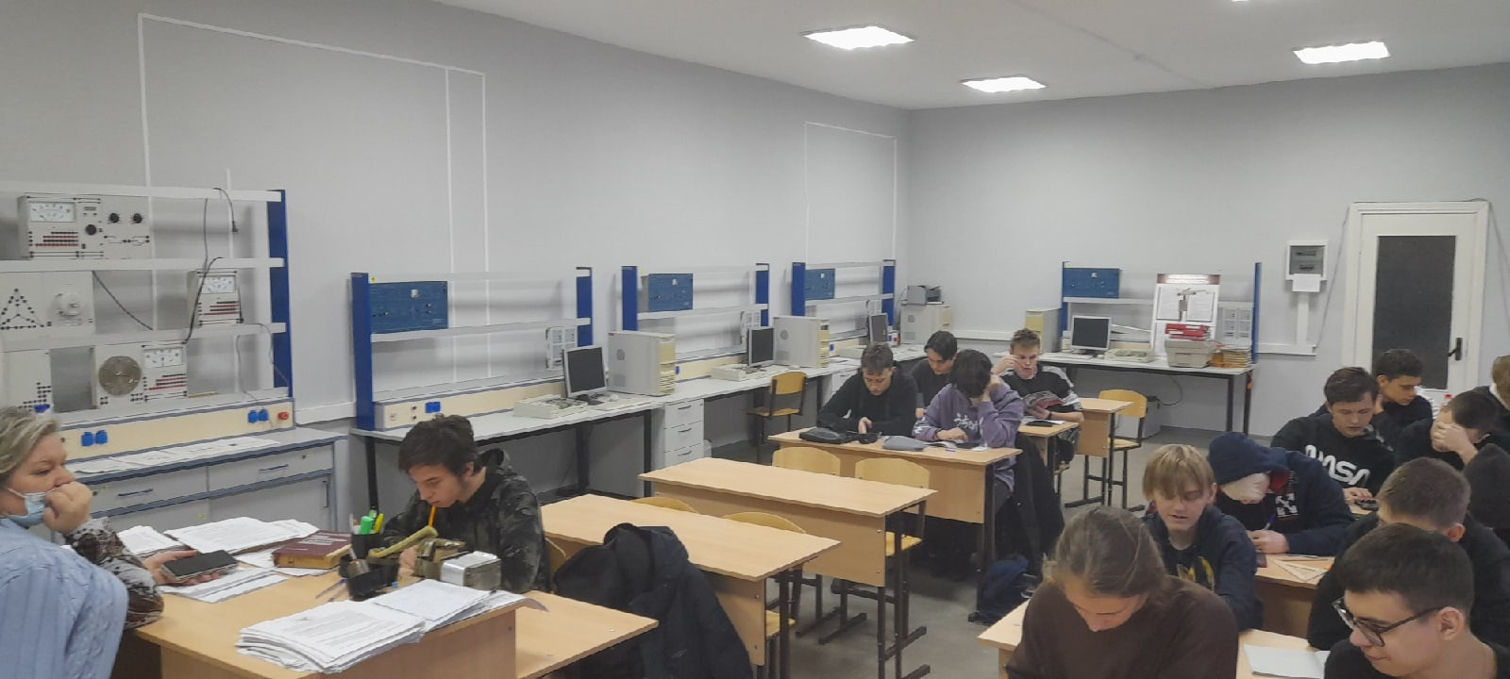
There is also a special laboratory where students can experiment with various electronic and measuring devices.

Slide 11
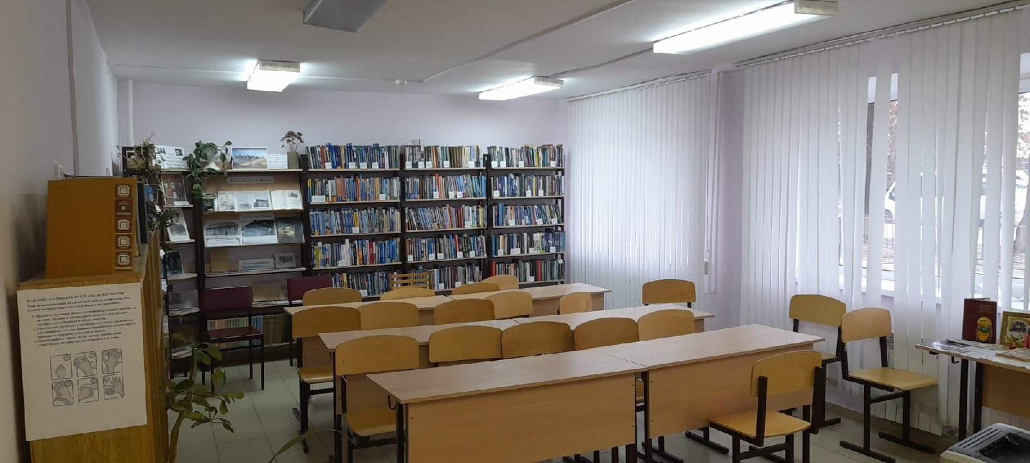
Of course, let's not forget to mention the library, which has a lot of interesting and useful books that will help you understand your profession at first.

Slide 12
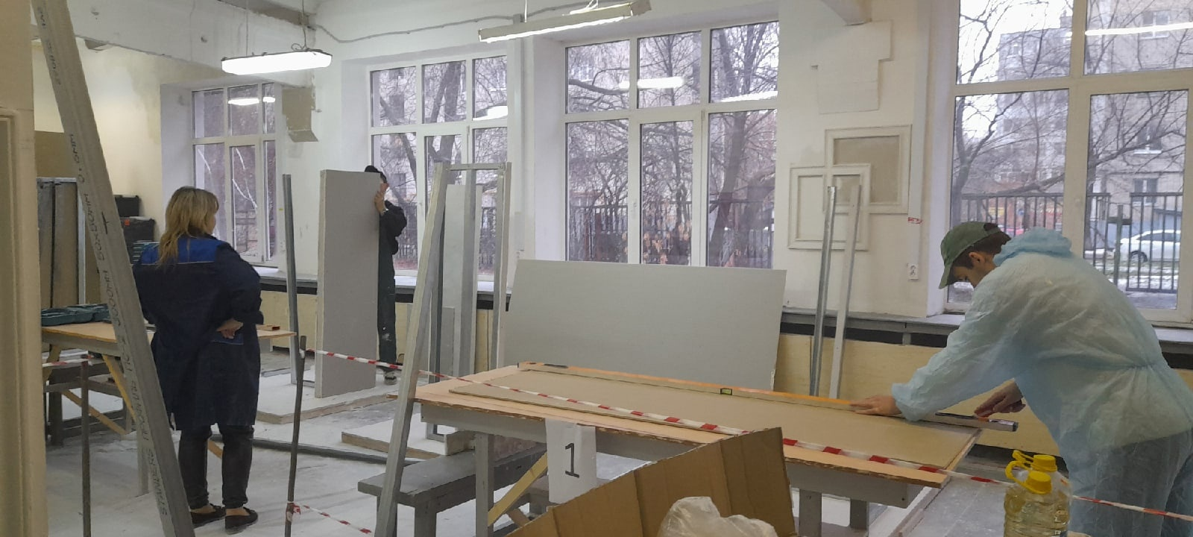
There are workshops in our college where students of construction specialties learn to create beautiful and durable structures with their own hands, which will delight everyone who looks at them in the future.

Slide 13
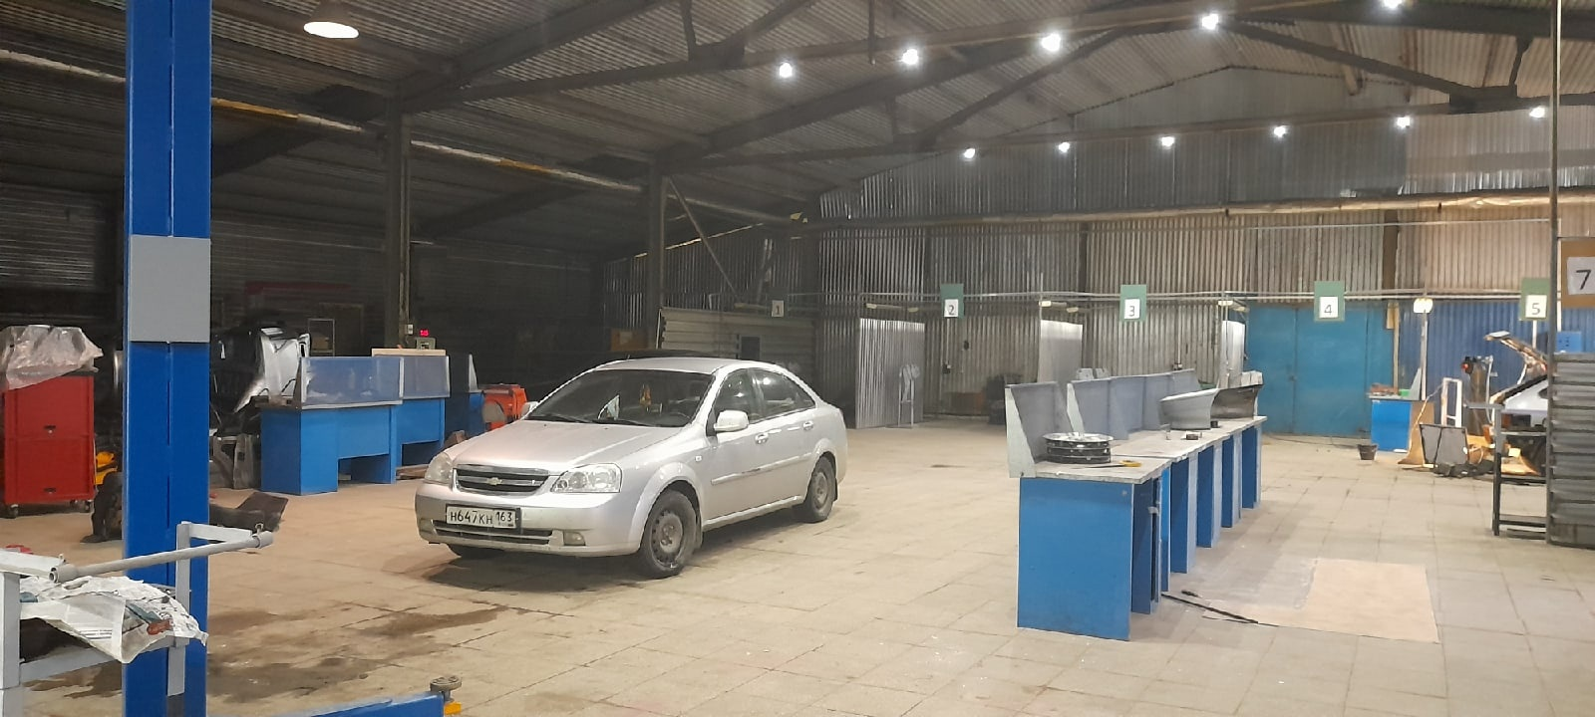
And auto mechanics have a separate, large hangar where they weld, repair and assemble cars completely with their own hands.

Slide 14

This is our beautiful conference room, where various important meetings are held, about upcoming events and decisions.

Slide 15
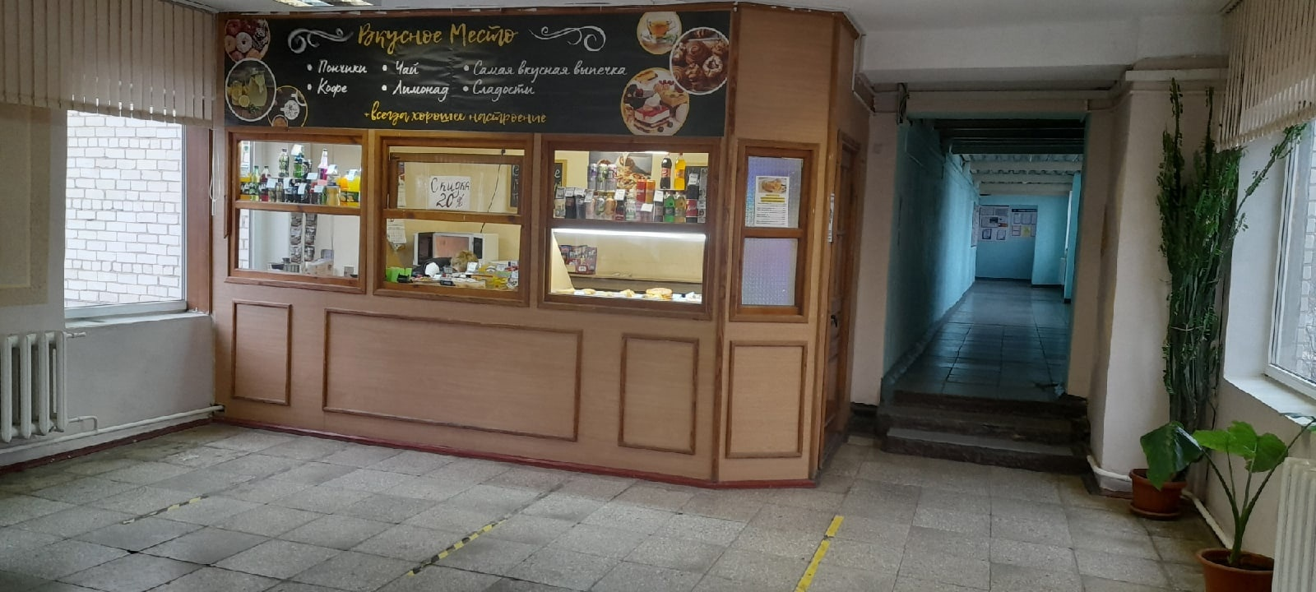
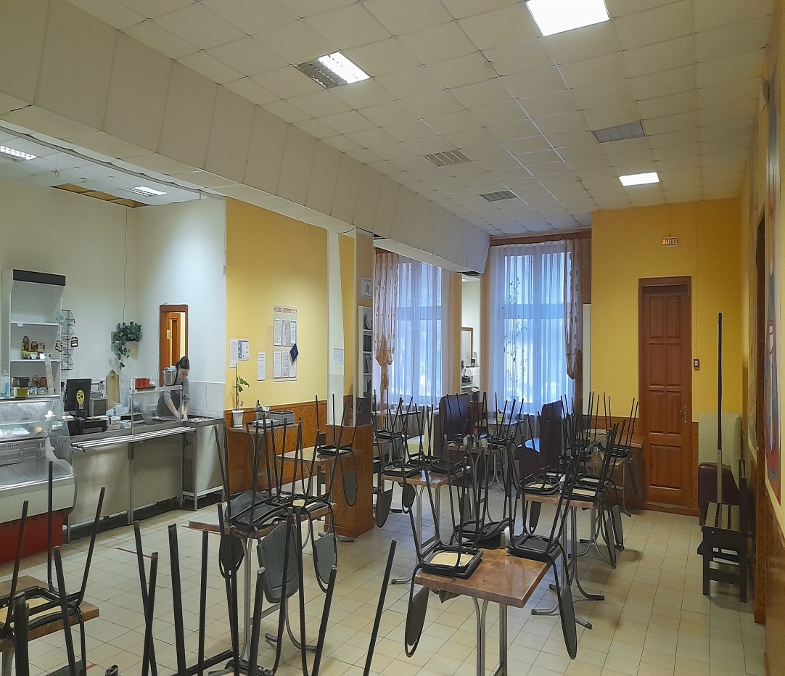
And this is our buffet and canteen, where students and teachers can have lunch and a snack quickly, tasty and cheaply.

Slide 16
The official name of our college is Togliatti Industrial and Pedagogical College.
The Vocational School No. 54 was established in Togliatti to train qualified workers in 1967. The opening of the educational institution coincided with the beginning of the construction of the Volga Automobile Plant, and it was at GPTU-54 that the first workers were trained for AvtoVAZ and other industrial facilities and construction organizations of the young city. This year it will celebrate its 55th anniversary.

Slide 17
Управление качеством продукции, процессов и услуг (по отраслям) – Quality management of products, processes and services (by industry)
Сетевое и системное администрирование – Network and system administration
Компьютерные системы и комплексы – Computer systems and complexes
Техническое обслуживание и ремонт двигателей, систем и агрегатов автомобилей - Maintenance and repair of engines, systems and assemblies of cars
- Мастер отделочных строительных и декоративных работ
Master of finishing construction and decorative works

Slide 18
Сварщик (ручной и частично механизированной сварки (наплавки) - Welder (manual and partially mechanized welding (surfacing)
- Мастер по ремонту и обслуживанию автомобилей - Car repair and maintenance master
Информационные системы и программирование
Information systems and programming
- Сервис домашнего и коммунального хозяйства
Household and communal services
Организация перевозок и управление на транспорте
- Organization of transportation and management of transport

Slide 19
Строительство и эксплуатация зданий и сооружений
Construction and operation of buildings and structures
Техническое обслуживание и ремонт автомобильного транспорта
– Maintenance and repair of motor vehicles

Slide 20
Information systems and programming
(Информационные системы и программирование)
computer –компьютер
cable - кабель
compact disc (= CD) – компакт диск
floppy disk – дискета
system unit – системный блок
memory - память
flash drive – флэш карта
modem - модем
desktop computer - настольный компьютер, стационарный компьютер
digital computer – цифровой компьютер
monitor– монитор
floppy disk drive - дисковод

Slide 21
laptop / notebook - ноутбук
mouse – мышь, мышка
motherboard – материнская плата
scanner - сканер / сканирующее устройство
data - данные (информация, хранящаяся на компьютере, в любом виде - текстовом, графическом, аудио, видео, и т.д.)
keyboard – клавиатура
cursor– курсор
printer - принтер
hardware– аппаратное обеспечение
software - программное обеспечение

Slide 22
Teachers’ Training College of Physical Culture of Olympic reserve | Shakhty Pedagogical College | Industrial and Pedagogical College | Technological College | Kazan Medical College
Mark

