Slide 1
«Healthy lifestyle» Здоровый образ жизни Формы глаголов в настоящем времени
Государственное бюджетное профессиональное образовательное учреждение «Тольяттинский Медицинский Колледж»
Преподаватель высшей квалификационной категории
Крупенкова Мария Владимировна

Slide 2
Цель занятия:
Научиться составлять рекомендации по правилам здорового образа жизни для иностранных граждан.

Slide 3
Hello! Nice to meet you!
Лиджуан
(Lidzuan)
Гуанмин (Guangming)

Slide 4
Актуальность
Food
Sport
Regimen
Health and Life

Slide 5
QUIZ

Slide 6
Level 1
Задания базового уровня

Slide 7
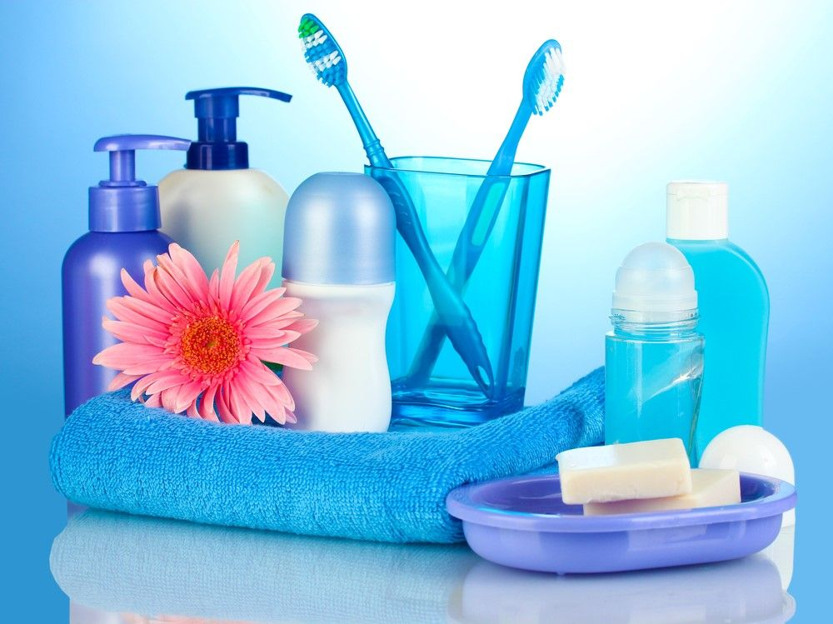
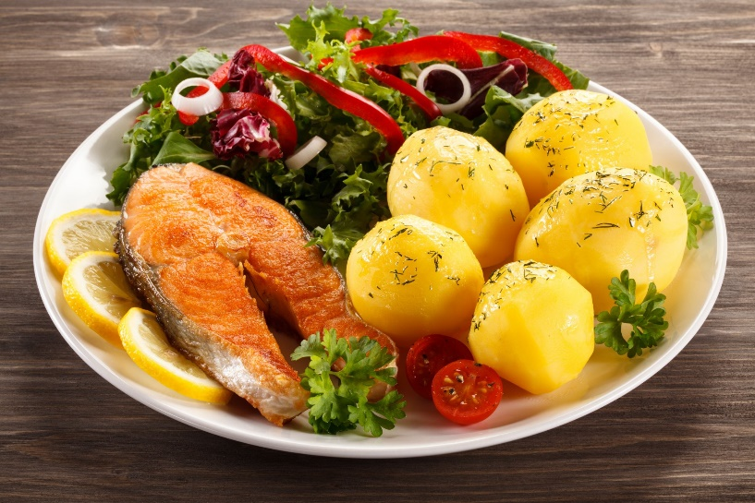
1. o,r,t,s,p
2. l,h,a,h,e,t
Sports
Health
5. y,h,g,e,e,n,i
Hygiene
3. e,e,p,l,s
4. o,o,d,f
Sleep
Food

Slide 8
Level 2

Slide 9
A sound mind in a sound body.
Guess the proverb
В здоровом теле — здоровый дух.

Slide 10
An apple a day keeps the doctor away.
Guess the proverb
Одно яблоко в ночь гонит доктора прочь.

Slide 11
Fit as a fiddle.
Guess the proverb
Здоров как бык.

Slide 12
Diet cures more than lancet.
Guess the proverb
Правильное питание заменяет докторов.

Slide 13
The greatest wealth is health.
Guess the proverb
Величайшее богатство это здоровье.

Slide 14
Dry feet, warm head bring safe to bed.
Guess the proverb
Держи голову в холоде, а ноги в тепле.

Slide 15
Time is the great healer.
Guess the proverb
Время - лучший доктор.

Slide 16
Level 3
Задания повышенной сложности

Slide 17
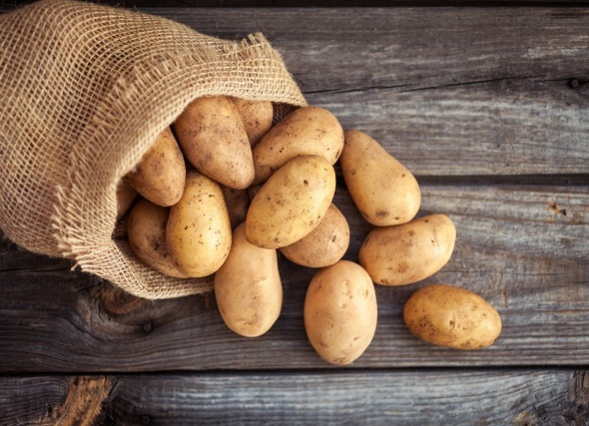
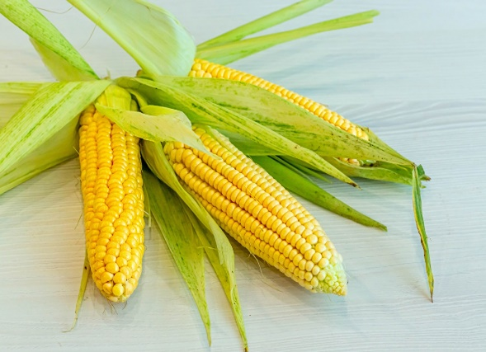
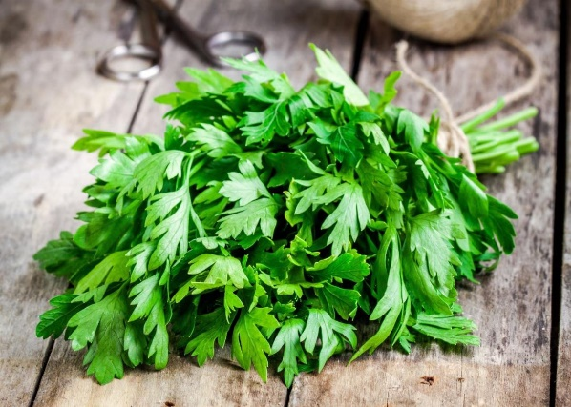
Find the odd word.
Buckwheat
Peas
Potato
Corn
Parsley

Slide 18
A simple carbohydrate

Slide 19
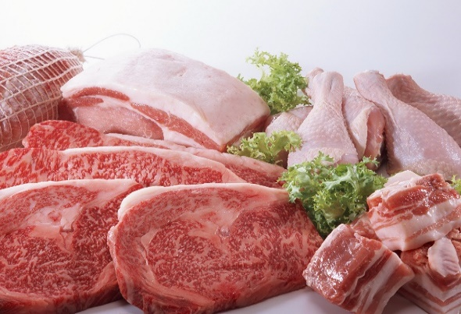
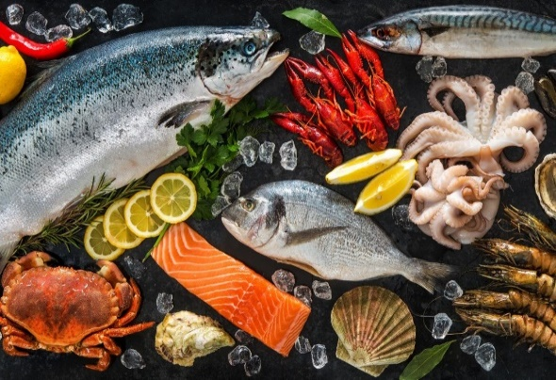
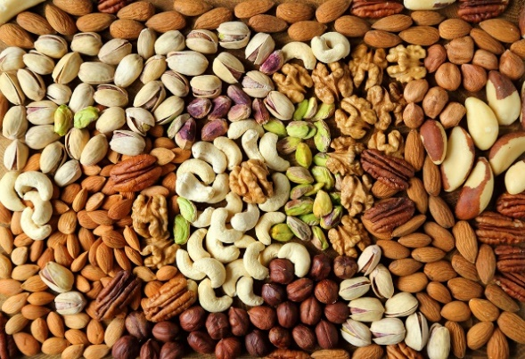
Find the odd word.
Milk
Eggs
Meat
Fish
Nuts

Slide 20
Vegetable fats

Slide 21
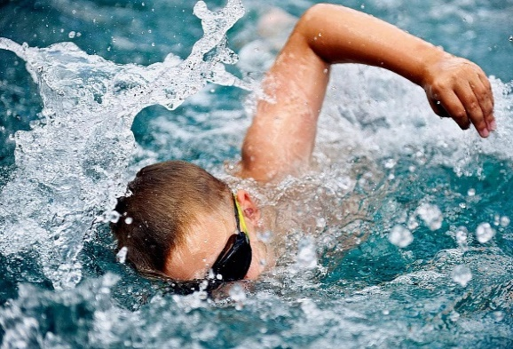
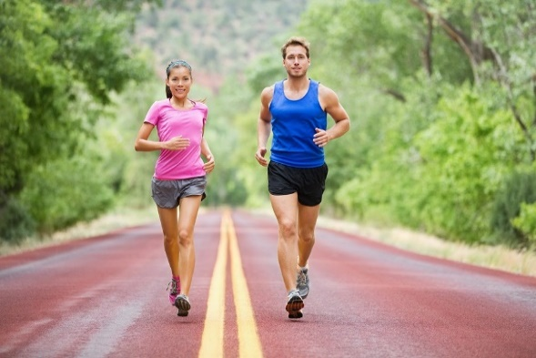
Find the odd word.
Breathing through your mouth
Walking
Swimming
Sleeping
Running

Slide 22
It is correct to breathe through the nose

Slide 23
Fairy tale The Present Simple Tense.

Slide 24
V
S

Slide 25
He
V
She
It

Slide 26
The Present Simple Tense 3 лицо, единственное число
I like swimming.
She likes walking.

Slide 27
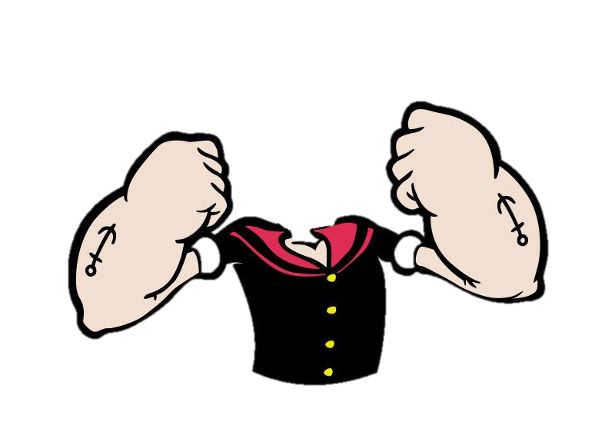
V
To do

Slide 28
The Present Simple Tense 3 лицо, единственное число
Do + not
I don’t like cycling
Don’t

Slide 29
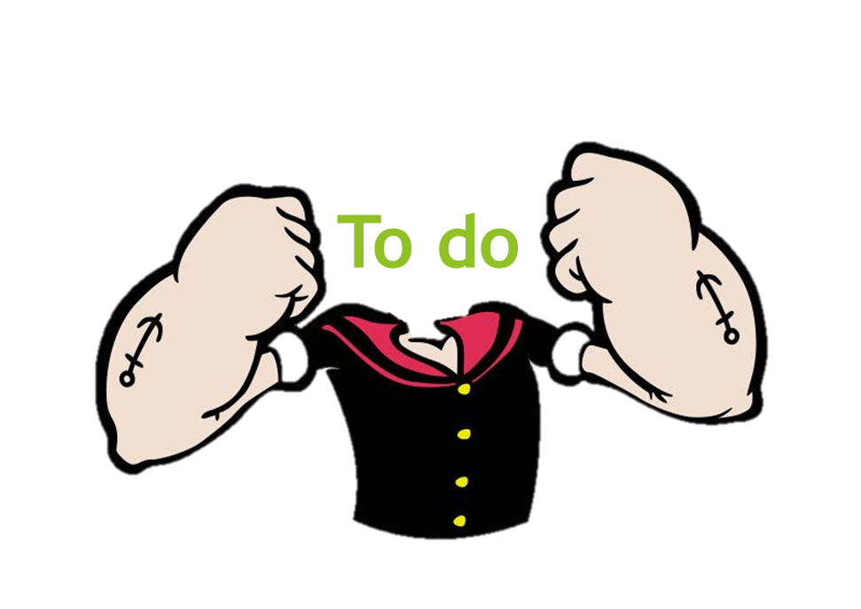

Slide 30
The Present Simple Tense 3 лицо, единственное число
He
V
She
doesn’t
It
She doesn’t like watching TV

Slide 31
The Present Simple Tense 3 лицо, единственное число
Do you
like sport?
Does she

Slide 32
+ | - | ?
V
don’t V
Do_V?
He
Vs
He
He
Does
V?
She
She
doesn’t V
She
it
it
it

Slide 33
Good luck!
V

Slide 34
Check yourself! The Present Simple Tense
Test № 1
Test № 2
Test № 3
Test № 4

Slide 35
Check yourself! Healthy lifestyle
Test № 1
Test № 2
Test № 3
Test № 4

Slide 36
Work in pairs!

Slide 37
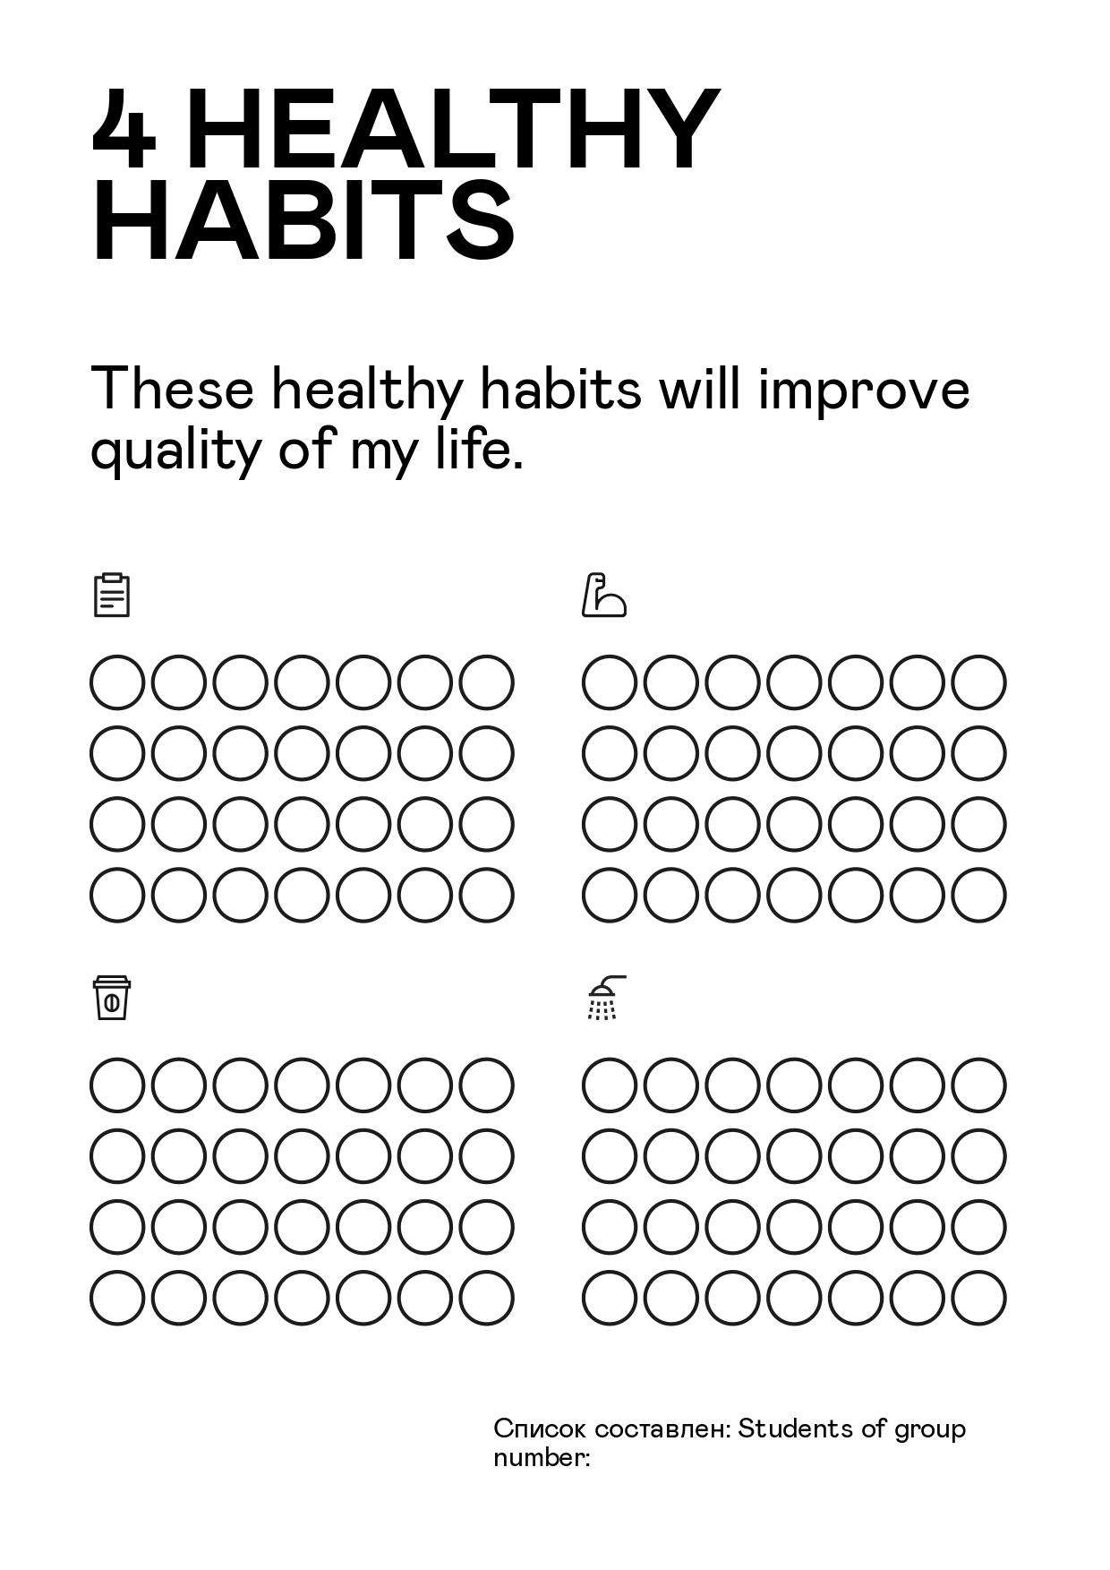
I swear…

Slide 39
Teambuilding

Slide 40
Lidzuan Age 32 Height 1,54 Weight 70 kg
Guangming Age 35 Height 1,62m Weight 128 kg

Slide 41
Healthy pregnancy
Organise Early Prenatal Care
Eat Wholesome and Nutritious Food
Drink Plenty of Water
Take Prenatal Supplements
Exercise Regularly
Get Some Rest
Avoid Alcohol, Drugs and Smoking
Reduce Caffeine and Recharge With Fruits
Eliminate Environmental Dangers
See Your Dentist
Watch Your Emotional Health
Strengthening Pelvic Floor Muscles
Track Your Weight Gain
Wear Appropriate Clothing and Footwear
Take Care of Your Skin
Pamper Yourself
Educate Yourself
Stress Management

Slide 42
Healthy lifestyle
Make an appointment with your doctors.
Take some measurements.
Start a journal.
Build a support group.
Write up a meal plan.
Eat mindfully.
Maintain a balanced diet.
Pay attention to portion sizes.
Drink more water.
Limit alcohol.
Consider supplements.
Boost your serotonin levels naturally.
Aim for 150 minutes of cardio each week.
Include strength training.
Follow the 80/20 rule.
Give up smoking.
Manage stress.
Get more sleep.

Slide 43
Критерии оценки
21 and more – Well done!
16 - 20 – Good job!
11 – 15 - Not bad!
10 and less - Try again!

Slide 44
Now I know…
I like…
I don’t like…

Slide 45
WELL DONE! Take care of yourself!

